Slide 1
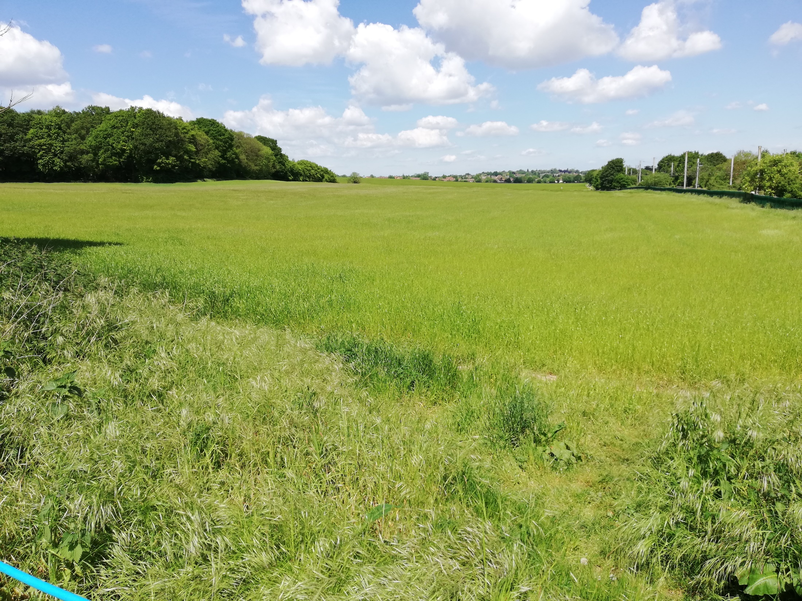
Public meeting 4th June 2019
Regarding
Local Plan – Call for Sites
Promoted Sites Consultation
Deadline 18th June

Slide 2
Status of WHBC Local Plan
Local Plan put out to consultation in 2016
12,000-12,500 extra dwellings
Submitted May 2017 for assessment by Independent Govt Planning Inspector
Anticipated approval and adoption in Autumn 2017
Now considerably delayed
Plan falls short of the required 16,000 dwellings
New “Call for Sites”
Promoted sites out for consultation – deadline 18th June

Slide 3
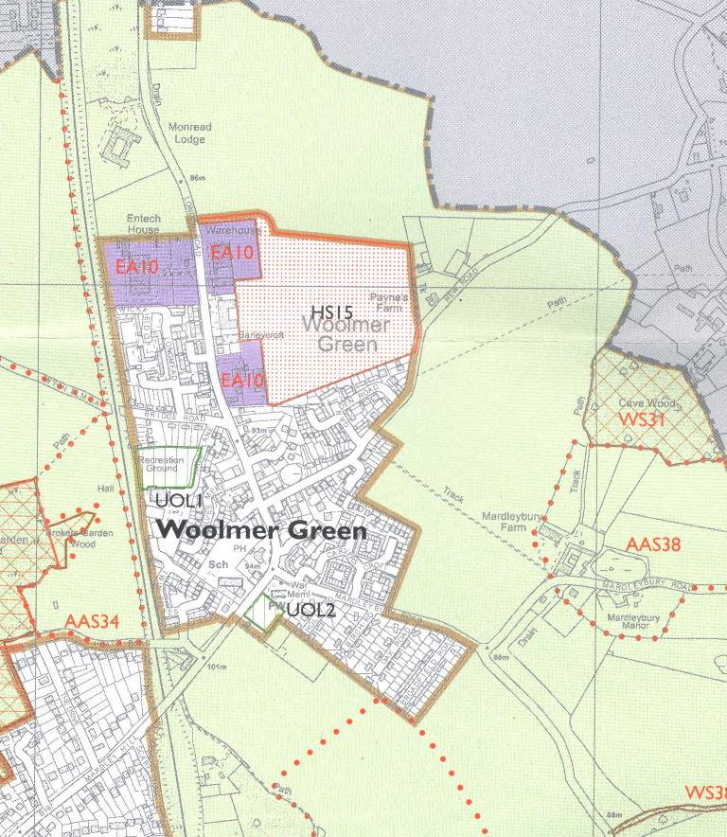
Reminder of 2016 Situation for Woolmer Green
150 new dwellings on site HS15 – currently Green Belt
Employment land EA10 includes the land occupied by Entech, Lessiters, Cawdor and Marshalls

Slide 4
PC’s & Residents’ Position Following Oct 2016 Public Meeting
Current Green Belt Boundary should remain
150 houses is far too many – ca 25% increase!!
Brownfield sites of Entech and Marshall’s should be used and re-designated to mixed use
Could provide all or majority of the 150 dwellings
Entech now approved for 72 dwellings + shops/offices
We do not believe “Exceptional Circumstances” have been demonstrated – Govt policy
This remains the PC’s default position

Slide 5
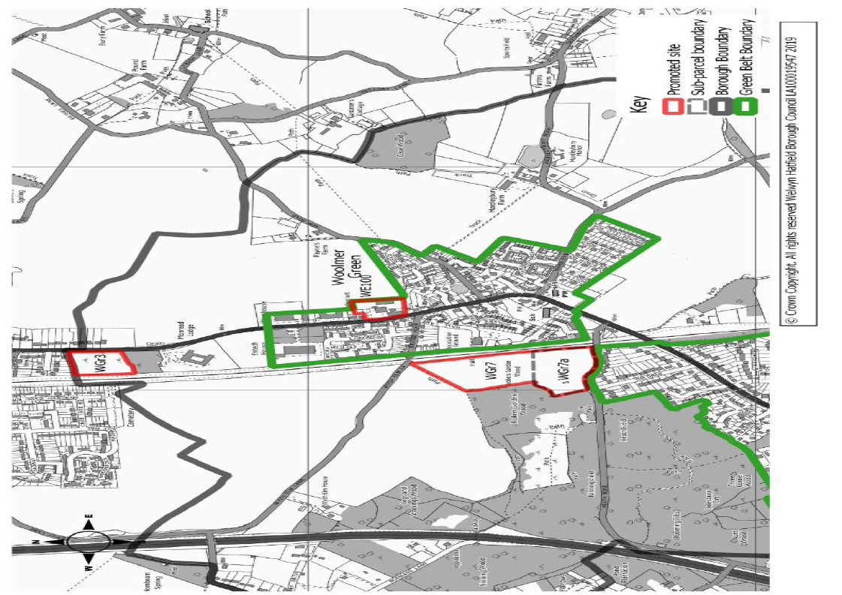
Woolmer Green -Promoted Sites

Slide 6
Woolmer Green - Promoted Sites
Site | Type | Promotion | # Dwellings
WE100 | Urban | a) housing with opp for convenience store; access to HS 15 b) housing, employment & retail | Not specified est. ca 45
WGr3 | Green Belt | Housing | 40
WGr7 | Green Belt | Housing | 135
WGr7a | Green Belt | Housing | 75
Additional dwellings: 220 (160 with WGr7a)
With Entech & HS15: ca 442 dwellings – 74% increase in size of Woolmer Green settlement !!

Slide 7
Green Belt Review

Slide 8
Consider Impact Of Neighbouring Developments
7,600 dwellings proposed or Stevenage (LP adopted 22 May)
Knebworth and Codicote are two of five villages identified in the North Herts Local Plan that could “support higher levels of growth”
364 dwellings are proposed for Codicote in North Herts Plan
Over 600 dwellings are proposed for Knebworth in North Herts Plan
98 dwellings are proposed for Welwyn in the Local Plan. Promoted sites have identified land that could accommodate 820 dwellings.
Promoted sites in Digswell – up to 347 dwellings
What will be the impact of all of this extra housing on local infrastructure?
B197, Schools, Doctors surgeries, water supply and sewerage, utilities etc, etc

Slide 9
Promoted Sites Consultation – What Can You Do?
We encourage you to respond to the consultation to express your views
Online via the consultation portal: https://welhat.gov.uk/promoted_sites_2019
By completing a comments form available on the Borough website and emailing to localplan@welhat.gov.uk
Deadline is 5pm on Tuesday June 18th
Links:
consultation: https://welhat.gov.uk/promoted_sites_2019
Local Plan documents: https://www.welhat.gov.uk/localplanexamination

Slide 10
Points to Consider in Responses
General - no exceptional circumstances exist – brownfield available
Numbers of dwellings far too high – few facilities in Woolmer Green - impact on character and community of village – impact of development in surrounding areas
WE100 – We support this site. Marshalls and Entech would provide Woolmer Green’s contribution to housing need
If you support the development of the Marshalls site make sure you say that in your response

Slide 11
Points to Consider in Responses
WGr3
The Borough has already assessed and rejected this site as it would weaken the Green Belt Boundary and “reduce an existing fragile Green Belt gap”
Coalescence with Knebworth
Urban sprawl as the development is well beyond the village envelope
If Woolmer Green has a development beyond its built edge it leaves the gap between Entech & Knebworth vulnerable
WGr7/7a
Green Belt Study identifies this area as “most essential” Green Belt
Coalescence with Mardley Hill/Oaklands – GB study recognises fragile gap
Access to London Road is over a narrow railway bridge with no pedestrian footpath
Adjoins Mardley Heath Nature Reserve - Different habitats are an essential part of the diverse ecology of an area.
Accumulation of traffic past the school
Isolated urban sprawl

Slide 12
Back Up Slides

